Slide 1

Task-Switching in Schizophrenia: brain activity and compensation mechanisms
Costanza Cantalini, Erica Bistacchia, Lorenzo Ferrara and Scott Pesenti Tutors: Prof. Laura Maria Sangalli, Dr. Eleonora Arnone Ph.D, Dr. Letizia Clementi

Slide 2
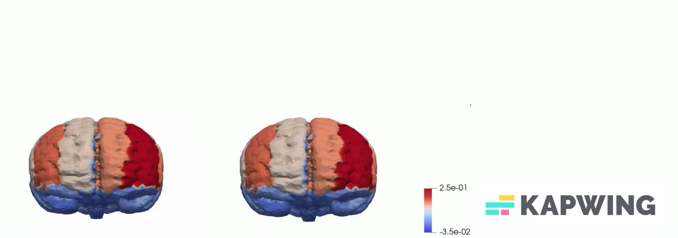
Task-Switching in Schizophrenia: brain activity and compensation mechanisms
Neurotypical individual
Schizophrenic
individual

Slide 3
Task-Switching in Schizophrenia: brain activity and compensation mechanisms
Neurotypical individual
Schizophrenic
individual

Slide 4
Task-Switching in Schizophrenia: brain activity and compensation mechanisms
Neurotypical individual
Schizophrenic
individual

Slide 5
Task-Switching in Schizophrenia: brain activity and compensation mechanisms
Neurotypical individual
Schizophrenic
individual

Slide 6
Task-Switching in Schizophrenia: brain activity and compensation mechanisms
Neurotypical individual
Schizophrenic
individual

Slide 7
Task-Switching in Schizophrenia: brain activity and compensation mechanisms
Neurotypical individual
Schizophrenic
individual

Slide 8
Task-Switching in Schizophrenia: brain activity and compensation mechanisms
Neurotypical individual
Schizophrenic
individual

Slide 9
Task-Switching in Schizophrenia: brain activity and compensation mechanisms
Neurotypical individual
Schizophrenic
individual

Slide 10
Task-Switching in Schizophrenia: brain activity and compensation mechanisms
Neurotypical individual
Schizophrenic
individual

Slide 11
Task-Switching in Schizophrenia: brain activity and compensation mechanisms
Neurotypical individual
Schizophrenic
individual

Slide 12
Task-Switching in Schizophrenia: brain activity and compensation mechanisms
Neurotypical individual
Schizophrenic
individual

Slide 13
Task-Switching in Schizophrenia: brain activity and compensation mechanisms
Neurotypical individual
Schizophrenic
individual

Slide 14
Task-Switching in Schizophrenia: brain activity and compensation mechanisms
Neurotypical individual
Schizophrenic
individual

Slide 15
Task-Switching in Schizophrenia: brain activity and compensation mechanisms
Neurotypical individual
Schizophrenic
individual

Slide 16
Task-Switching in Schizophrenia: brain activity and compensation mechanisms
Neurotypical individual
Schizophrenic
individual

Slide 17
Task-Switching in Schizophrenia: brain activity and compensation mechanisms
Neurotypical individual
Schizophrenic
individual

Slide 18
Task-Switching in Schizophrenia: brain activity and compensation mechanisms
Neurotypical individual
Schizophrenic
individual

Slide 19
Task-Switching in Schizophrenia: brain activity and compensation mechanisms
Neurotypical individual
Schizophrenic
individual

Slide 20
Task-Switching in Schizophrenia: brain activity and compensation mechanisms
Neurotypical individual
Schizophrenic
individual

Slide 21
Task-Switching in Schizophrenia: brain activity and compensation mechanisms
Neurotypical individual
Schizophrenic
individual

Slide 23
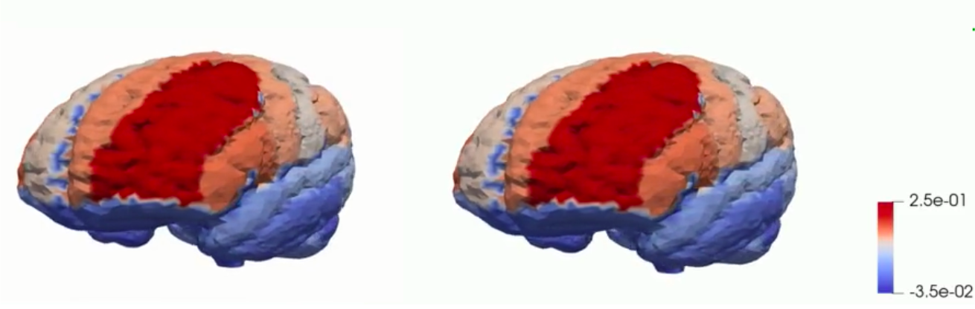
Task-Switching in Schizophrenia: brain activity and compensation mechanisms
Neurotypical individual
Schizophrenic
individual

